Slide 1
Antopia: Week 1 Report
Alex, Ben, Triet, Xander
Your gateway into the ant kingdom
A wiki covering various ant species

Slide 2
User Uploading and Downloading
Requirements finished:
As a user, I want to be able to press an upload button on the page so I can import various file types that I see necessary
Cloc: total LoC 26
LoC added in base.html 3
LoC added in routes.py 14
LoC added in upload.html 9
Burndown rate: 15%

Slide 3
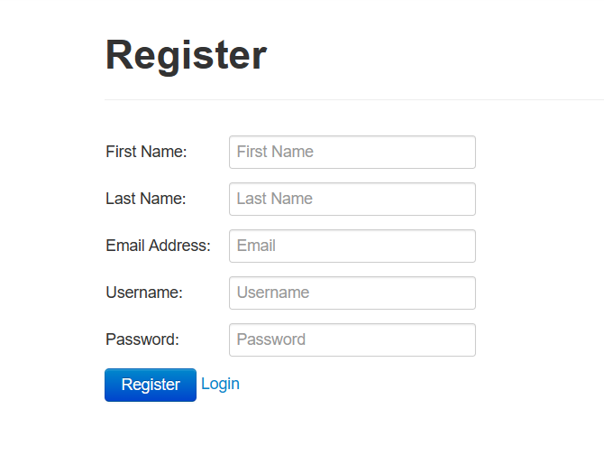
User Creation and Authentication
Requirements finished:
As a User, I want to navigate between Login Page and Register Page, so that I can login with my created account or make a new one anytime I want.
Cloc: total LoC 76
Cloc add to register.html = 51
Cloc add to forms.py = 12
Cloc add to routes.py = 10
Cloc add to base.html = 3
Burndown rate: 30%

Slide 4
Analytics
Requirements finished:
As a user, I want to be able to track analytics on the site to be able to see popular results and figure out what the community is actively interested in, so that I can stay involved on the wiki community.
Cloc: total LoC 13
Page.html LoC = 12
Analytics.html LoC = 1
Burndown rate: 10%

Slide 5
Search / Advanced Search
No update
LoC = 0
Burndown rate: 0%
Requirements 0
Milestone 5: 4/10 : Finish feature
Milestone: Able to create skeleton code and lay out functions

Slide 6
Milestones &
Risk Analysis

Slide 7
15%
Burndown rate for the week
115 LoC written

Slide 8
Questions?

